Slide 1
WELCOME TO OUR PRESENTATION

Slide 2
Group name: Infinity
Submitted by:
Akteruzzaman
152-15-5671
2.Samyamay Howlader Niloy 152-15-5913 3. Muzahidul Islam 152-15-5585 4. Md. Jakir Hassan 152-15-5617 5. Saniatul Haque Taposh 152-15-5545
Submitted to:
Ms. Farah Sharmin
Senior Lecturer
Department of Computer Science and Engineering
Daffodil International University

Slide 3
TRANSMISSION MEDIA
Fiber Optic Cable

Slide 4
Over view of transmission medias:-
Introduction:-
There are four types of media that can be used in transmitting information in telecommunications system, which are:
Copper wire
Coaxial cable (actually an adaptation of copper wire)
Wireless
Fiber optic

Slide 5
Fiber Optic Cable
Fiber-optic cables are composed of a glass or plastic inner core surrounded by cladding, all encased in an outside jacket.
Fiber-optic cables carry data signals in the form of light. The signal is propagated along the inner core by reflection.
Relatively new transmission medium used by telephone companies in place of long-distance trunk lines.
Require a light source with injection laser diode (ILD) or light-emitting diodes (LED).

Slide 6
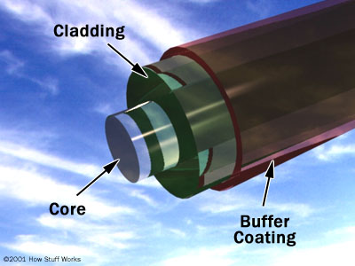
Construction of optical fiber
Core-this glass center of fiber where light travels.
Cladding-outer optical material surrounding the core.
Buffer coating-plastic coating that protects the fiber.

Slide 7
Refraction

Slide 8
Critical Angle

Slide 9
Reflection

Slide 10
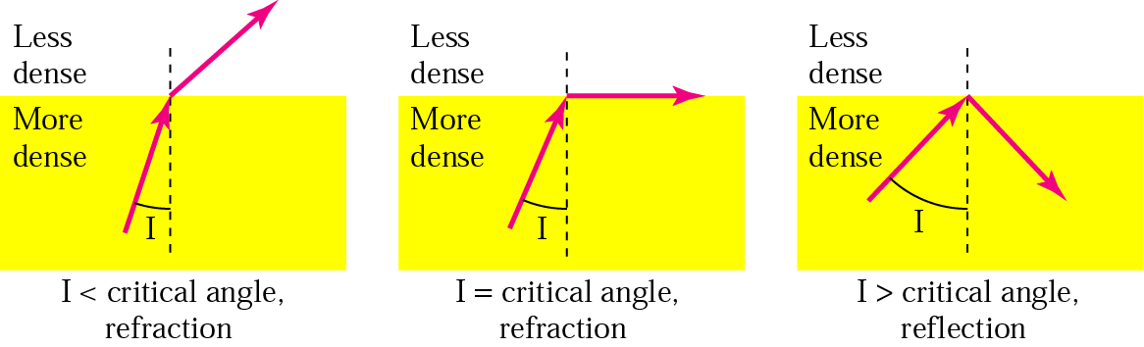
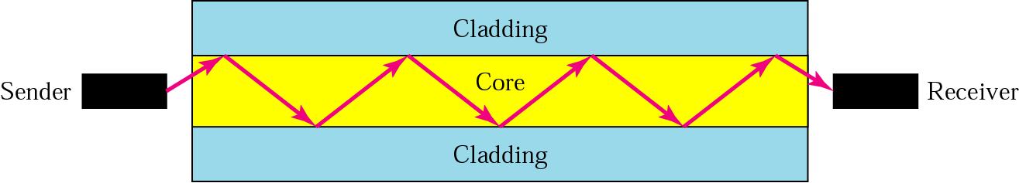
Refraction & Reflection

Slide 11
Types of Propagation Modes:

Slide 12
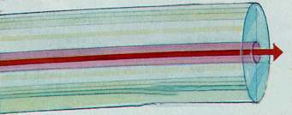
Single mode fiber:
Means only one single united beam running or passing through the core and taking the center of it from first to end.
Used for long distance applications(according to Tx equipment type).

Slide 13
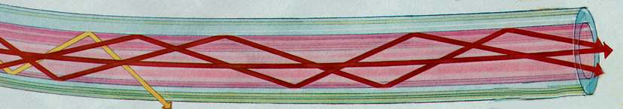
STEP-INDEX MULTIMODE FIBER :
STEP-INDEX multimode fiber has a large core, up to 100 microns in diameter.
In multimode step-index propagation, the core density is constant and some of the light rays changes direction suddenly at the interface between the core and the cladding.

Slide 14
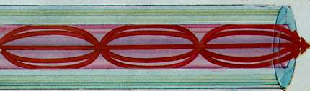
GRADED-INDEX MULTIMODE FIBER:
In multimode graded-index propagation, the core density decreases with distance from the center. This causes a curving of the light beams.
The higher refractive index at the center makes the light rays moving down the axis advance more slowly than those near the cladding.

Slide 15
Applications
Fiber optic can accommodate variety of needs.
It can be used in Communication, fiber optic sensors, illumination, medical.
And also in other places where bright light needs to be shone on a target without a clear line-of-sight path.
Used in building to route sunlight from the roof to other parts of the building.

Slide 16
Continued…
Optical fiber can be used as a medium for telecommunication and computer networking because it is flexible and can be bundled as cables.
It is especially advantageous for long-distance communications, because light propagates through the fiber with little attenuation compared to electrical cables.
In June 2013, researchers demonstrated transmission of 400 Gbit/s over a single channel.
Each fiber can carry many independent channels, each using a different wavelength of light.

Slide 17
Fiber Optic Advantages:
Higher transmission rate of 100Mbps.
It supports voice,video and data.
Greater capacity (bandwidth of up to 2 Gbps).
Smaller size and lighter weight
Lower attenuation
Immunity to environmental interference
Highly secure , it is almost impossible to tap into a fiber cable.
Safe and easy installation.
More compact & lighter than copper wire

Slide 18
Fiber Optic Disadvantages:
expensive over short distance
Unidirectional
requires highly skilled installers
adding additional nodes is difficult
Maintenance and repairing cost is high.

Slide 19
ThankYou!!!

